Slide 1

Logistic Regression Algorithm

Slide 2
Outline
Explain and visualize bias-variance tradeoff in the context of logistic regression algorithm.
Which hyperparameters for logistic regression you can tune in Python’s scikit-learn module and how?
Explain how do you evaluate accuracy of classification results produced by logistic regression algorithm.
Accuracy of results, bais-variance trade-off for regularized regression. How to solve optimization problem directly?
Describe and illustrate hyperparameter tuning for logistic regression.
Relate hyperparameter tuning and bias-variance tradeoff to cross-validation.
Show how to solve a classification problem using logistic regression algorithm

Slide 3
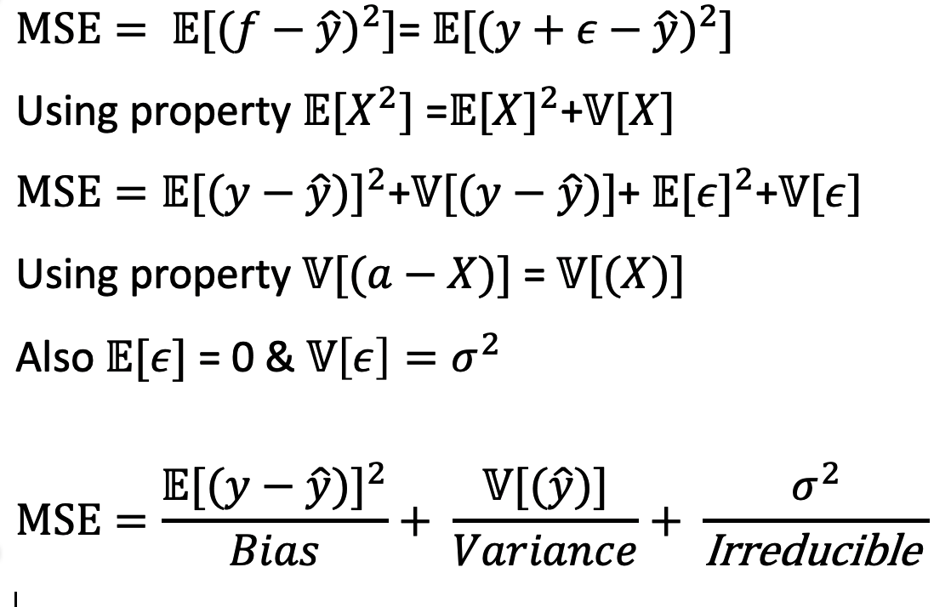
Error in Prediction
Supervised machine learning algorithms suffer error
during prediction introduced from the training dataset.
Notes:
Prediction error decomposition is called bias variance trade off.
Image graph source: https://towardsdatascience.com/understanding-the-bias-variance-tradeoff-165e6942b229

Slide 4
What is Bias?
What is Variance?
Bias is the difference between the average of actual output (y) and the predicted output (ŷ)
Model does not fit well on the training dataset and result in under fitting
Model with high bias oversimplifies the model.
Model with bias has high error on training as well as test datasets.
Variance is the variability in the model prediction for a given input (x).
Model fit too well on the training dataset and result in over fitting.
Model does not generalize on any new data.
Models with high Variance have higher accuracy on training dataset.
Model has higher error on test/validation dataset.
Notes:
Higher the bias more is the difference between the predicted values and actual values.
Higher the variance higher is the error in test set as model is fit too well on the training set.

Slide 5
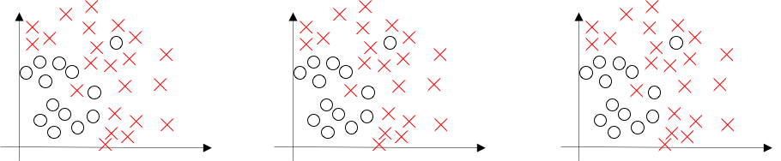
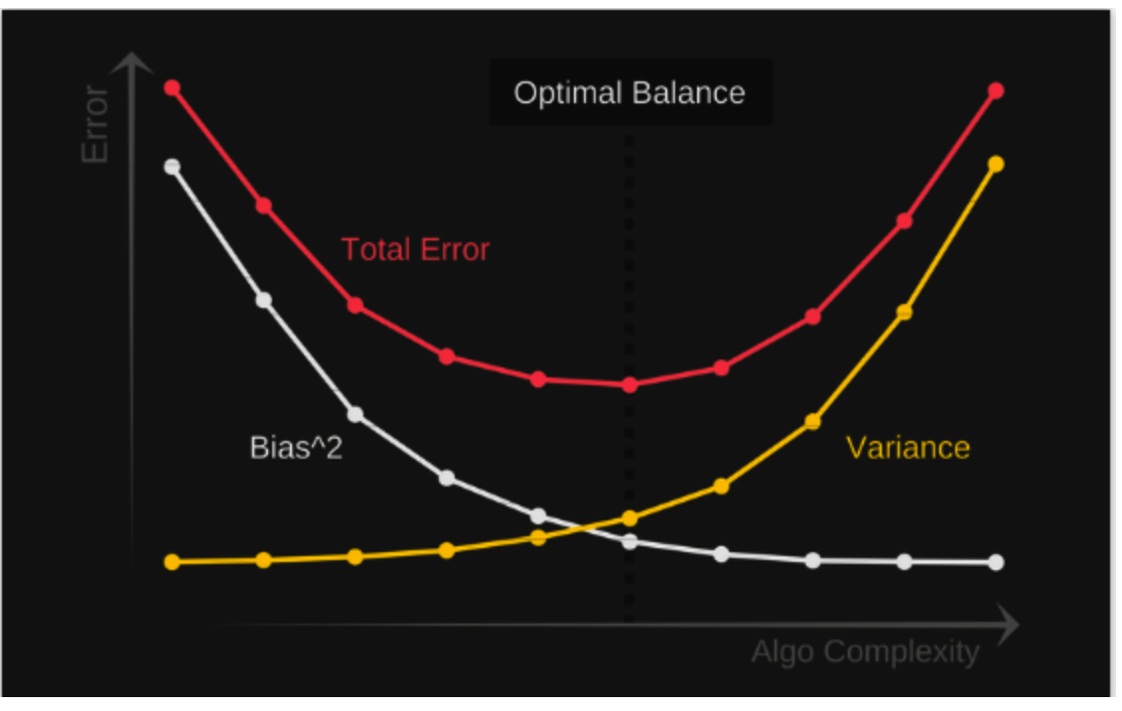
Bias-Variance in Logistic Regression
x1
x1
x1
x2
x2
x2
Under Fitting
Over Fitting
High Bias
High Variance
Training Set Error | 15% | 1% | 1%
Testing Set Error | 16% | 1.5% | 11%
 | High Bias | Low Bias and low Variance | High Variance
Notes:
If our model is too simple and has very few parameters then it may have high bias and low variance. On the other hand if our model has large number of parameters then it’s going to have high variance and low bias. So we need to find the right/good balance without overfitting and underfitting the data.
Image: Andrew Ng Deep Learning Specialization

Slide 6
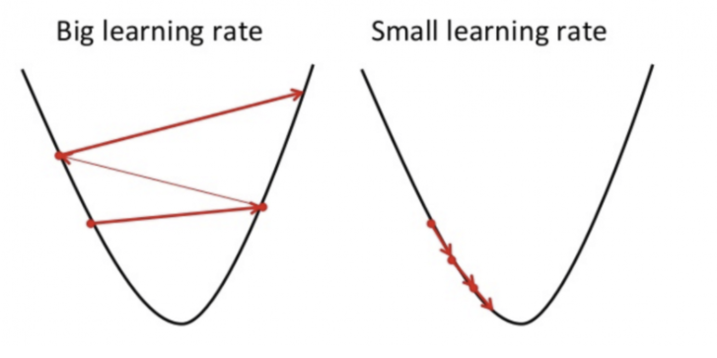


Hyperparameter Tuning for Logistic Regression
Hyperparameters:
Parameters whose values are used to control the training process are called hyperparameter.
Value of the hyperparameters are typically set before the learning process begins.
Hyperparameters in Logistic Regression
The cost function for logistic regression is given by:
One way to is by using Gradient Descent
Note: The learning rate 𝜶 is a hyperparameter which can be set during training
Notes:
Image source: https://builtin.com/data-science/gradient-descent

Slide 7
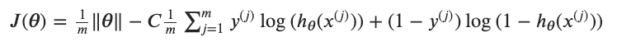
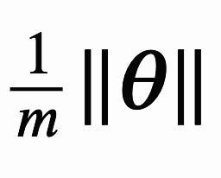
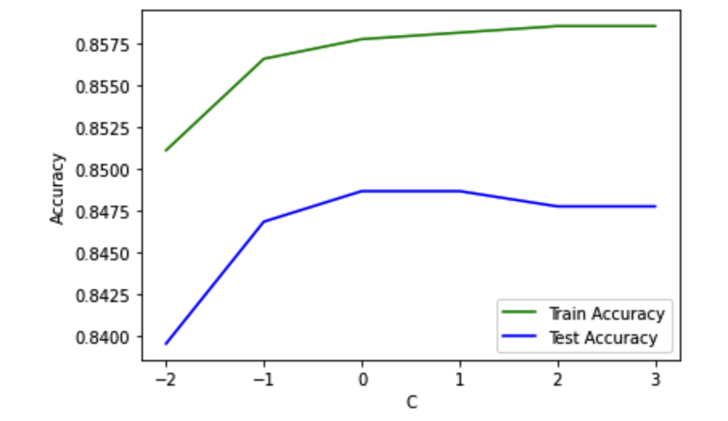
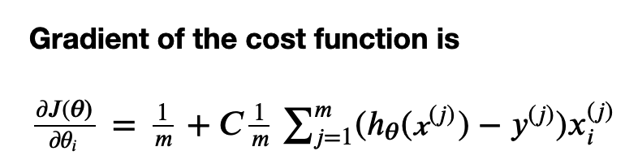
Hyperparameter Tuning for Logistic Regression
Regularization:
One of the ways we can reduce variance is by applying a penalty to parameters.
One of the ways is by using L1 Regularization.
L1 Regularization:
Where C is the inverse of a regularization strength. i.e. C = 1/𝛌
The first term penalizes large parameters in the model.
Note: C is a hyperparameter whose value can be selected.

Slide 8
Hyperparameter Tuning
C: trade-off parameter of logistic regression that determines the strength of the regularization. Basically smaller C specify stronger regularization.
float, default=1.0
class_weight: It penalizes mistakes in samples of class[i] with class_weight[i].
dict or ‘balanced’, default=None
solver: Algorithm to use in the optimization problem.
{‘newton-cg’, ‘lbfgs’, ‘liblinear’, ‘sag’, ‘saga’}, default=’lbfgs’
penalty: Used to specify the norm used in the penalization.
{‘l1’, ‘l2’, ‘elasticnet’, ‘none’}, default=’l2’
max_iter: Maximum number of iterations taken for the solvers to converge. Larger the number of iteration, the more accurate it will get.
int, default=100
Notes:
As mentioned before, hyperparameters are user defined parameters. However, we can try find the values of hyperparameters that can give the optimal solution. That process is called hyperparameter tuning.
Here are some hyperparameters you can tune for logistic regression. The C value, which is the trade-off parameter that determines the strength of regularization; the class weight, by how much you penalize mistakes in samples; solver, which algorithm to use, etc.

Slide 9
Strategies for Hyperparameter Tuning in sklearn –
Grid Search
Exhaustively generates candidates from a grid of parameter values specified with the param_grid parameter.
It will find the optimal combination in the defined sets of parameters, but with a longer processing time.
GridSearchCV()
Notes:
The two main techniques used for hyperparameter tuning are Grid Search and Random Search.
Grid search will exhaustively generates candidates from a grid of parameter values specified with the param_grid parameter. For example, if we supply it with a list of C values and a list of max_iter values, it will go through the combinations one by one (c1 with iteration1, c1 with iteration2, etc.), compute the accuracies for the model, and then compare the accuracies to get the best one.
It can be called by GridSearchCV in sklearn.

Slide 10
Strategies for Hyperparameter Tuning in sklearn –
Random Search
It searches the specified subset of hyperparameters randomly instead of exhaustively.
Decreases process time, but we might not find the optimal combination of hyperparameters.
RandomizedSearchCV()
Notes:
Similarly, for the random search method, you still supply it with a grid of parameter values. But this time, instead of compute the accuracies with every combinations, it will randomly select some of them, compute the accuracies and compare.
The benefit for this method is that, compared with Grid Search method, it can greatly decreases the processing time. However, there are chances that we miss the optimal combination through random selection.
And here’s the sklearn function for random search.

Slide 11
Cross Validation
Cross-validation is a resampling procedure used to evaluate machine learning models on a limited data sample.
we split the data into multiple sets, perform the training and testing, and compare the resulting scores.
cross_val_score()
Notes:
Maybe some of you notice that the sklearn function for Grid Search and Random Search method all have a CV at the end. That CV stands for cross-validation. It’s a resampling procedure used to evaluate machine learning models on a limited data sample. If we are only training and testing the model on one data set, we will receive the resulting model that only works well for this specific data set. But if we split the data into multiple sets, perform the training and testing, and compare the resulting scores for accuracy, we can see how well our model works for different data set.
For cross_val_score(), we specify our model; our data to fit; the target variables; the number of groups we want to split the data. It will split the data and fit with each set, compute the accuracies and compare to get the optimal one.

Slide 12
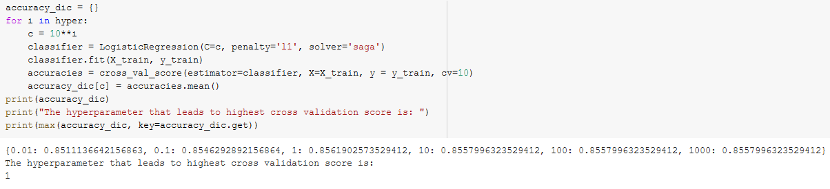
Hyperparameter Tuning With Cross-Validation
For each value of C, we evaluate the accuracies of the model by computing the cross-validation score.
Compare the score to determine which value of C gives the most accurate result.
Notes:
The concept of cross validation can be combined with hyperparameter tuning process. Here’s part of our code. Basically, we want to tune the parameter of C. For each value of C, we evaluate the accuracies by computing the cross-validation score. Then we compare the score to determine which value of C gives the most accurate result. And that’s exactly how the GridSearchCV and RandomizedSearchCV works.

Slide 13
Bias-variance tradeoff with cross-validation
Bias-variance tradeoff
Bias: difference between the actual output and the predicted output.
Variance: variability in the model prediction for a given input.
For cross-validation:
Less subgroups: higher bias, lower variance
More subgroups: lower bias, higher variance
Notes:
Also, the bias-variance tradeoff, defined in previous slides, can be related with cross-validation.
In cross-validation, if we only have one set of training data, the model we got will work well for the training data (low variance), but only for the training set (high bias). If we split the training data into too many subgroups, each subgroup will be more sensitive with changes in the data set (high variance). So to summarize, in cross-validation, when you have less subgroups, you will have higher bias and lower variance, if you split the data into more subgroups, you will have lower bias and higher variance.

Slide 14
Data Set for Logistic Regression
Coronary Heart Disease Risk Prediction (heartDiseaseData.csv)
Using males, age, education, smoker or non smoker, cigarettes smoked per day, and traditional risk factors such as blood pressure, cholesterol, diabetes, glucose levels, etc.
3656 records and 15 fields
Dependent variables are binary only (0, 1)
Classification goal: 10-year CHD risk prediction in males aged 32-70 considering various health factors
Notes:
Logistic regression was used to predict coronary heart disease risk, acquired from kaggle, with 3656 males aged 32-70. Factors such as education, smoker or non smoker, cigarettes smoked per day, blood pressure, cholesterol levels, diabetes, glucose levels and many more...with a total of 15 fields were used in this classification. In our dataset, all input variables were already converted to binary values, which is a requirement to perform logistic regression. The classification goal of predicting coronary heart disease based on the factors also outputs binary values, such that 1 = getting heart disease within the 10 year mark and 0 means they won't.

Slide 15
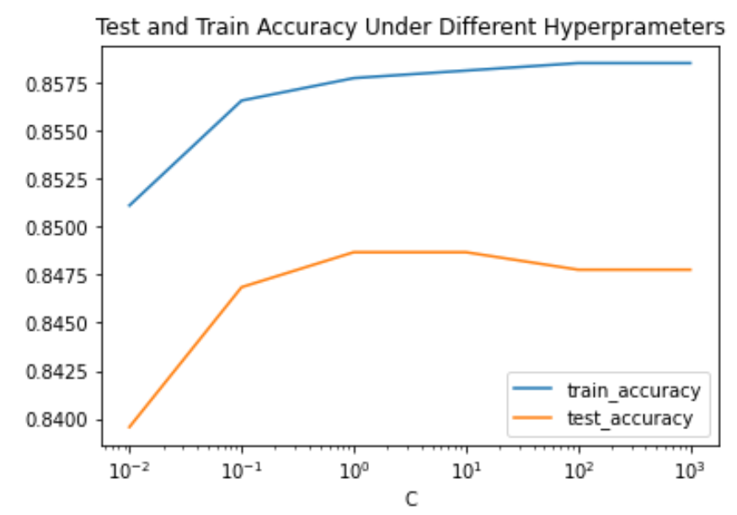
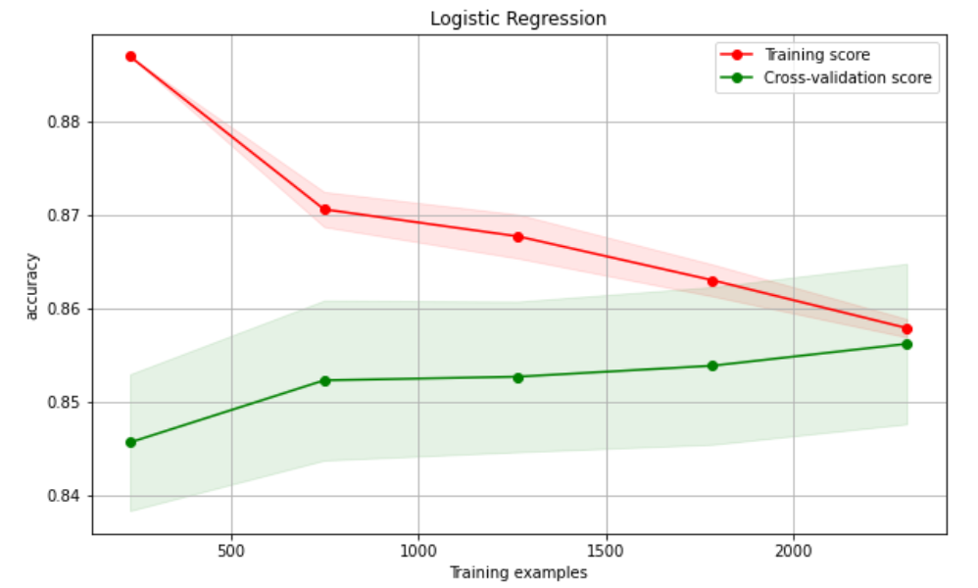
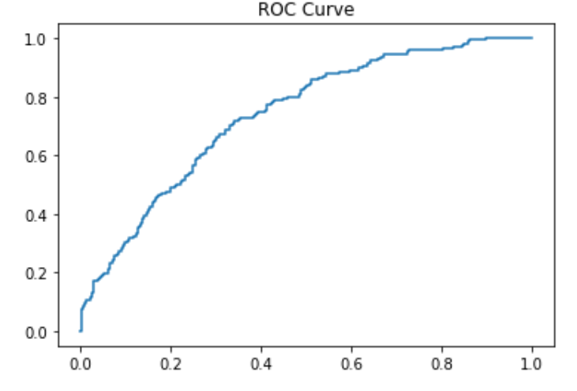
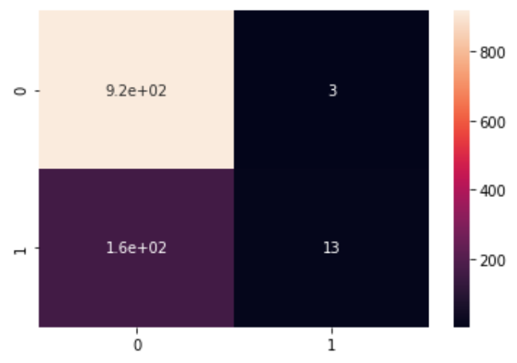
Accuracy Evaluation
FP
TN
ROC Curve
Confusion Matrix
True Positive Rate
Actual
FN
Predicted
TP
False Positive Rate
Notes:
The figure on the top left corner shows the accuracies on train and test data with different hyperparameters, C. As C increases, training accuracy always increases which is shown by the blue curve. Howver, there is an optimal C value for highest accuracy for test data. As shown after a C value of 1, the test accuracy starts to decrease because it is overfitting the data. For our model, the highest testing accuracy is given by C of 1.
The figure in the top right shows the convergence of accuracies for training score and cross-validation score as the number of training examples increase. This shows that the model is viable for prediciton.
The ROC or receiver operating characteristic curve is a tool used with binary classifiers. The red line represents the ROC curve of a purely random classifier. A good classifier stays as far away from that line as possible so toward the top-left corner. By looking at the ROC curve, it can be deemed that the classifier used is viable.
So after we train a logistic regression model on some training data, we need to evaluate the performance of the model on some test data which can be done by using a confusion matrix as shown on the bottom right corner. The x-axis is our prediction (0 for no coronary heart disease, 1 for coronary heart disease within 10 years). Similarly, The y-axis is what actually happened. Here True positive is when we predicted yes and the actual value was true and True negative are cases in which we predicted no and the actual value is false. Based off the confusion matrix, we can state that our model was 84% accurate with a a 14% error in our model.

Slide 16
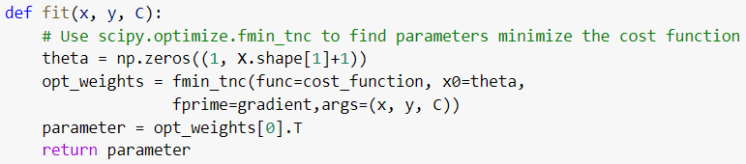
Directly solving the optimization problem
from scipy.optimize import fmin_tnc
Minimizes a function with variables subject to bounds
Uses gradient information in a truncated Newton algorithm; wraps a C implementation of the algorithm
Notes:
A method to directly solve the optimization problem is by using the sigh pie.optimize module. It minimizes a function with variables subject to bounds using gradient information in a truncated Newton algorithm. This method wraps a c implementation of the algorithm. We reference the cost function, with initial estimate of theta, to the gradient and arguments of x,y and c to pass the function. More information on defining the differncnt mathematical functions can be found on the jupyter notebook.

Slide 17
Thank you for listening!
Notes:
Thank you for listening.

